Slide 1
PROJECT: CROWDFIX
TEAM MEMBERS
1, B.K DOL BAHADUR(230191)
2, BASNET ANJALI (2301461)
3, SAPKOTA PRATIK (230175
4, BHOTE UMANG(2301515)

Slide 2
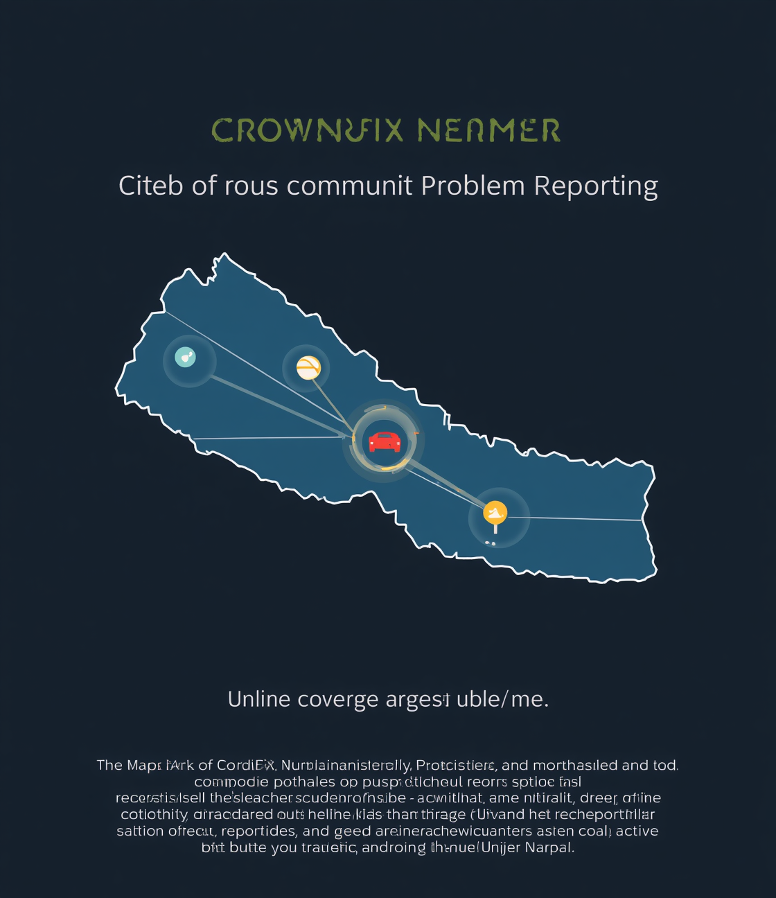
CrowdFix Nepal
Department of Information Security

Slide 3

Community Reporting for Nepal
Empowering Citizens to Report Issues
Citizens can easily identify problems
Streamlined Reporting Process for Authorities
Reports are routed to relevant offices
Enhancing Civic Engagement and Transparency
Upvotes prioritize community concerns

Slide 4
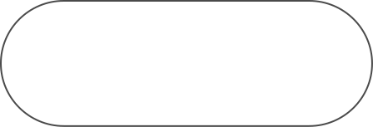
Key Features of CrowdFix Nepal
Geotagging
Community Engagement
Interactive Map
Reports are linked to specific locations.
Users view all reported issues visually.
Citizens can upvote and comment on issues.
Authority Dashboard
Notifications
Municipal authorities can manage and track reports.
Users receive updates on report statuses.

Slide 5
CrowdFix Nepal: Scope Definition
In Scope
Out of Scope
Key features include user registration, geotagged reporting, community interaction, authority dashboards, and notifications.
Future phases exclude integration with legacy systems and AI image classification capabilities.

Slide 6
Understanding User Interactions and Roles
Use Case Dynamics
Visual representation of user interactions

Slide 7
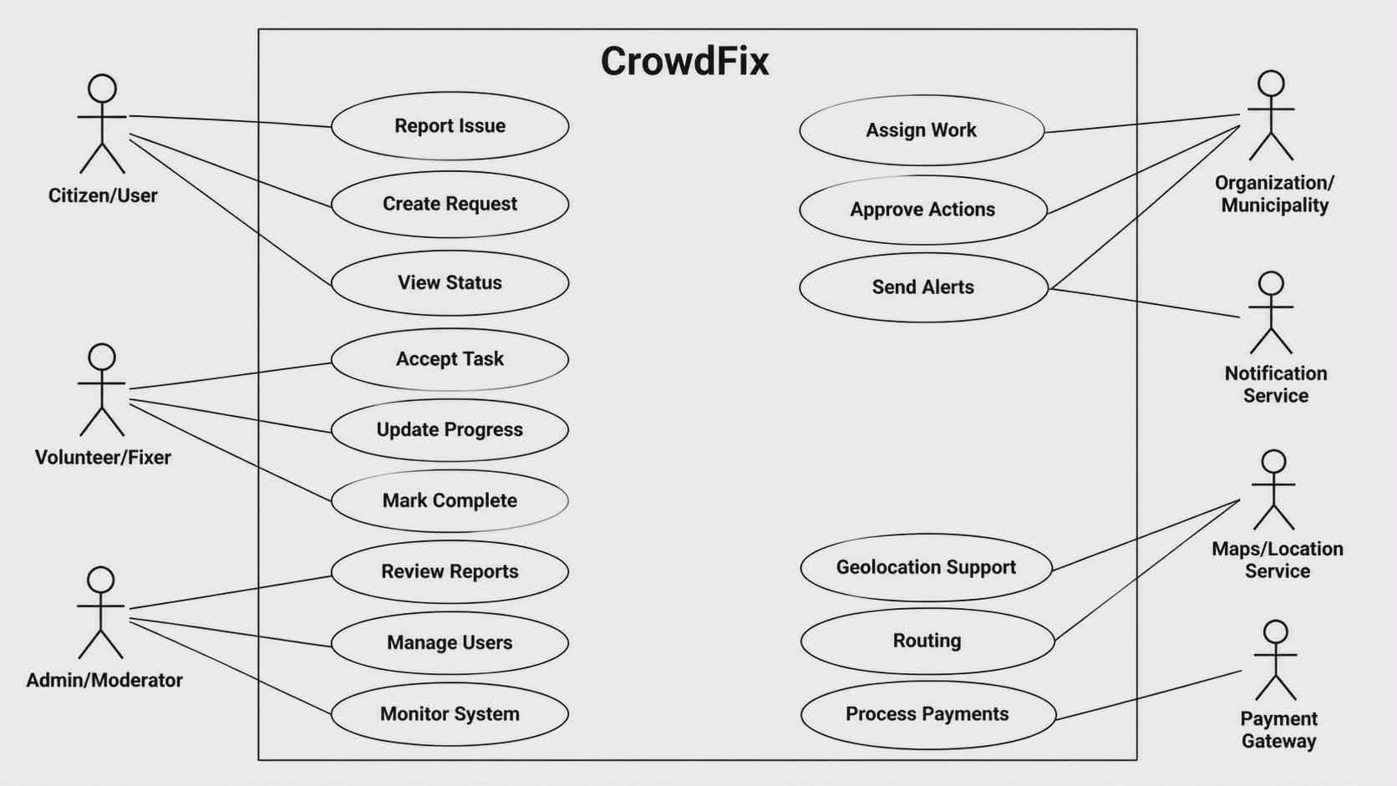

Slide 8
CrowdFix Nepal Context Diagram
Visual Representation of System Interactions
Illustrating entities and data flow connections

Slide 9
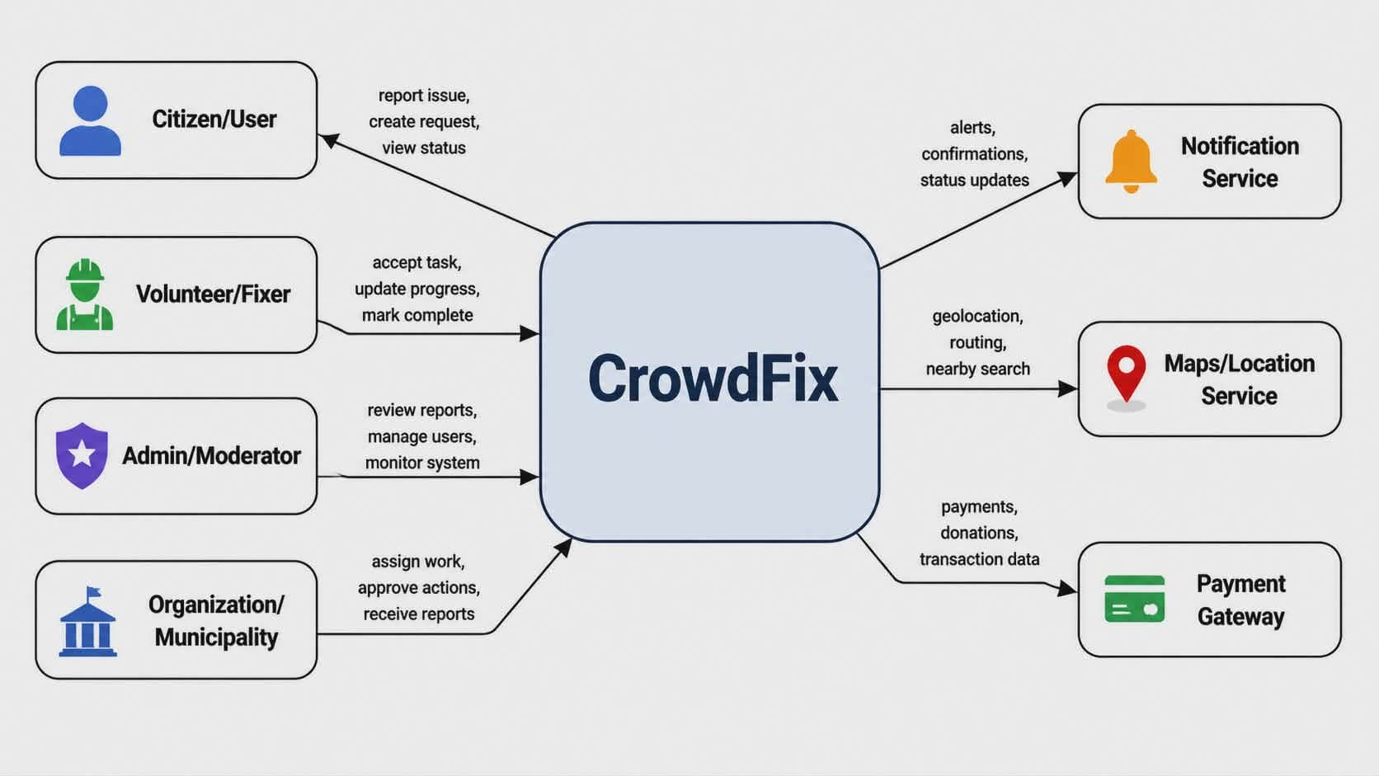

Slide 10
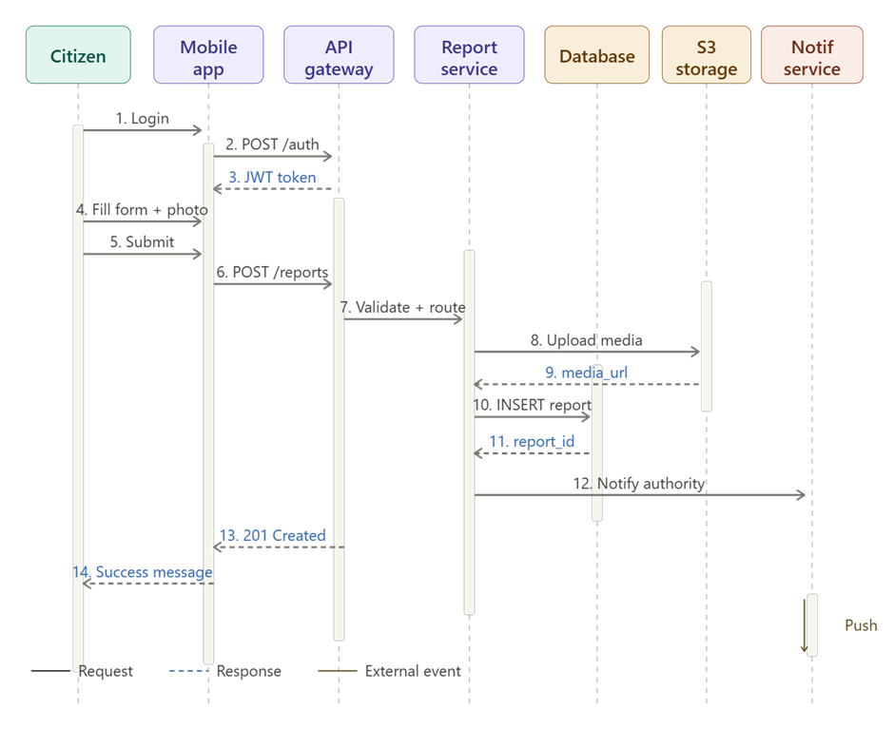
Report Submission Process Overview
Simplified sequence of actions
Visualizing the steps for effective reporting

Slide 11
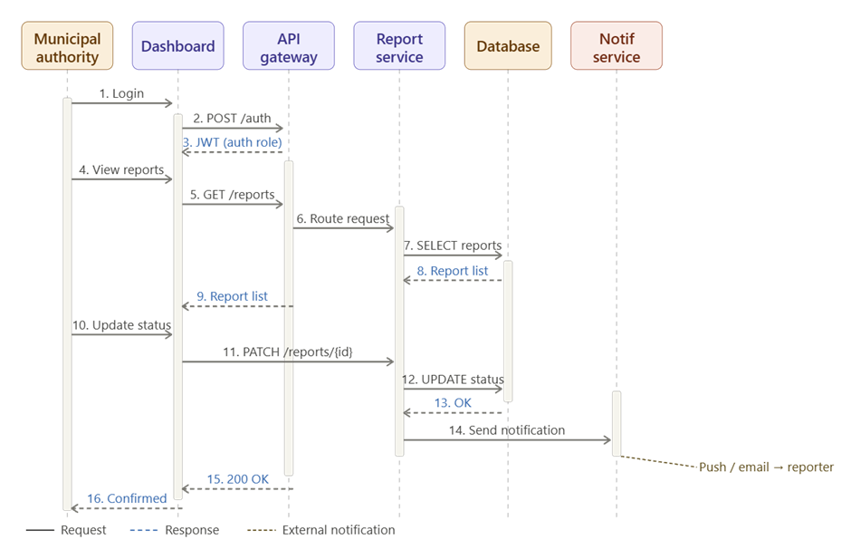
Report Submission Process Overview
Simplified sequence of actions
Visualizing the steps for effective reporting

Slide 12
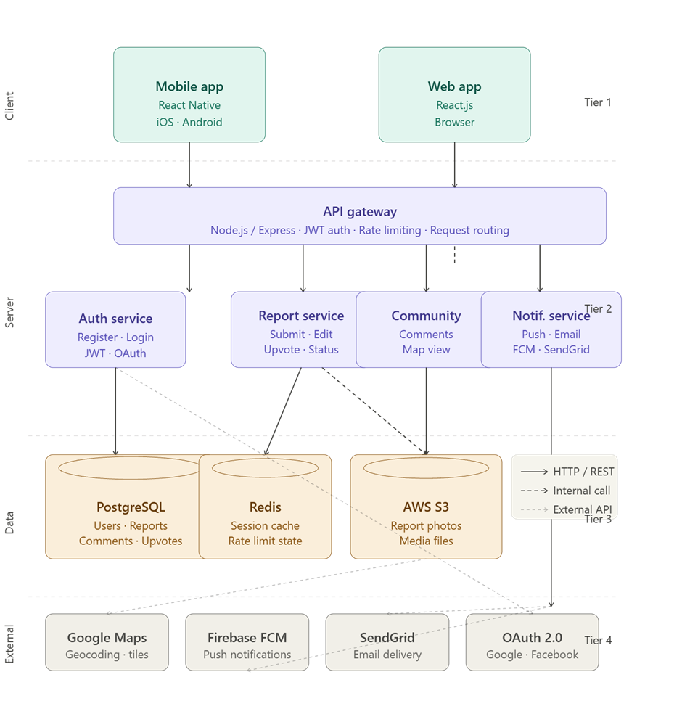
CrowdFix Nepal Client-Server Architecture
Comprehensive system structure overview
Visual representation of the client-server architecture showing all tiers and interactions.

Slide 13
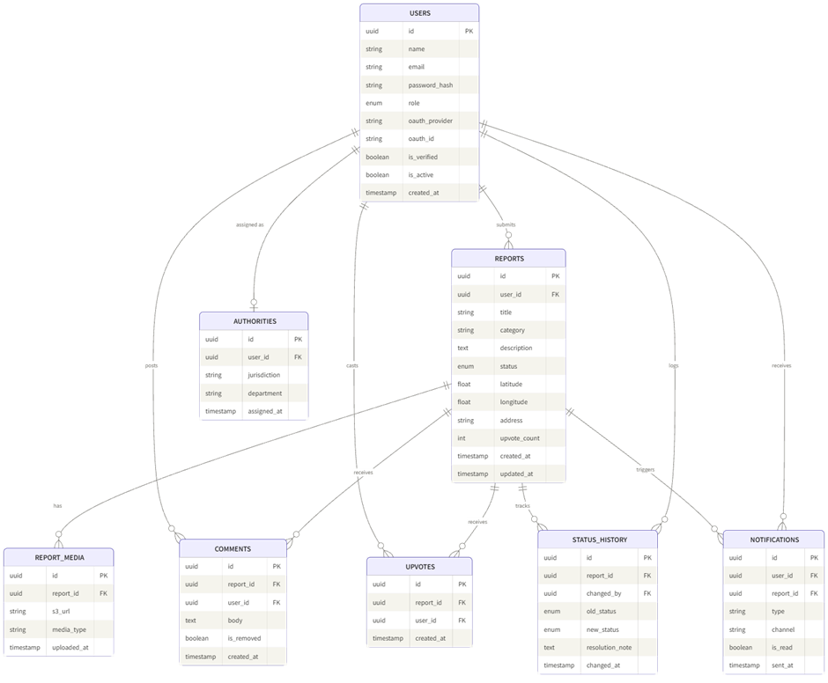
CrowdFix Nepal Database Schema Overview
Visual Representation of Relationships
Detailed structure of user and report interactions

Slide 14
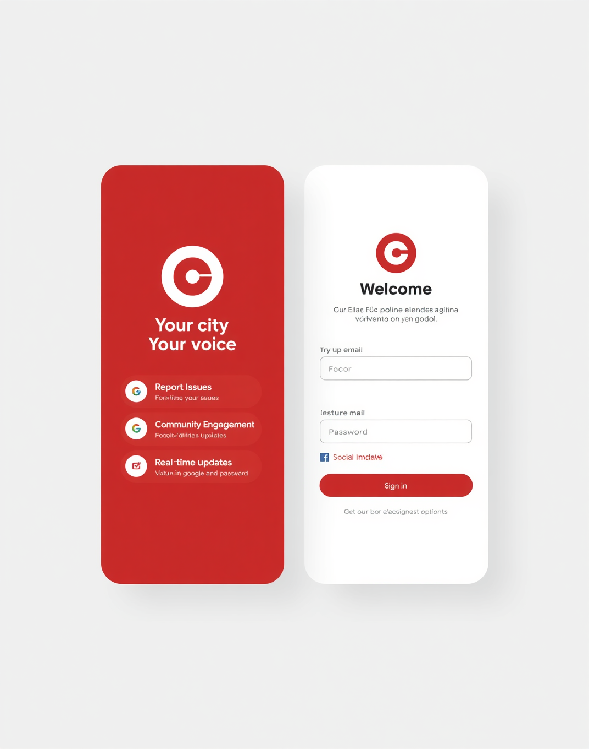
Mockup of CrowdFix Nepal Login Screen
User-Friendly Interface for Problem Reporting
The CrowdFix Nepal login screen features a clean design and intuitive layout, allowing users to quickly access the platform for reporting local issues and engaging with their community.

Slide 15
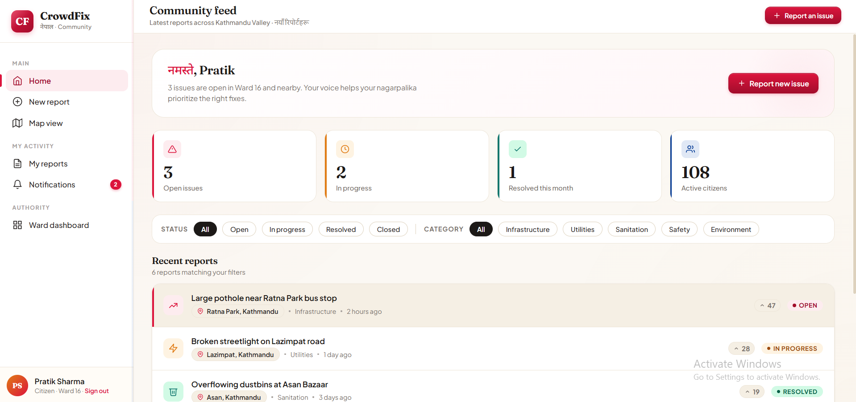
Thank You

